Slide 1
Threat Intelligence Using Machine Learning and Open Source Indicators of Compromise
Teddy Katayama
Advanced Security Research & Government
July 26, 2017

Slide 2
Teddy Katayama
University of Delaware
ECE – Cyber Security
3rd Year PhD Student
Dr. Chase Cotton & Dr. Haining Wang
S&TO – ASRG
IoC discovery / Data Analytics
Machine Learning
TIP, CSIRT, InfoSec

Slide 3
IoC - Background

Slide 4
What are IoCs?
IP Address
Hostname
Text Strings
Atomic IoC
Email Address
Process Name
File Names
Behavioral IoC
MD5 Hash
Statistics
Computed IoC
Regex

Slide 5
IoC Distribution of Intelligence Sources
Notes:
Privacy and Information Hiding

Slide 6
Standardized formats for sharing Threat Intelligence
CAPEC
Common Attack Pattern Enumeration and Classification
CybOX
Cyber Observable eXpression
IODEF (RFC5070)
Incident Object Description Exchange Format
MAEC
Malware Attribute Enumeration and Characterization
OpenC2
OASIS Open Command and Control
STIX 2.0
Structured Threat Information eXpression (STIX) language
TAXII
Trusted Automated eXchange of Indicator Information
VERIS
Vocabulary for Event Recording and Incident Sharingn

Slide 7
IoC Discovery & Observations

Slide 8
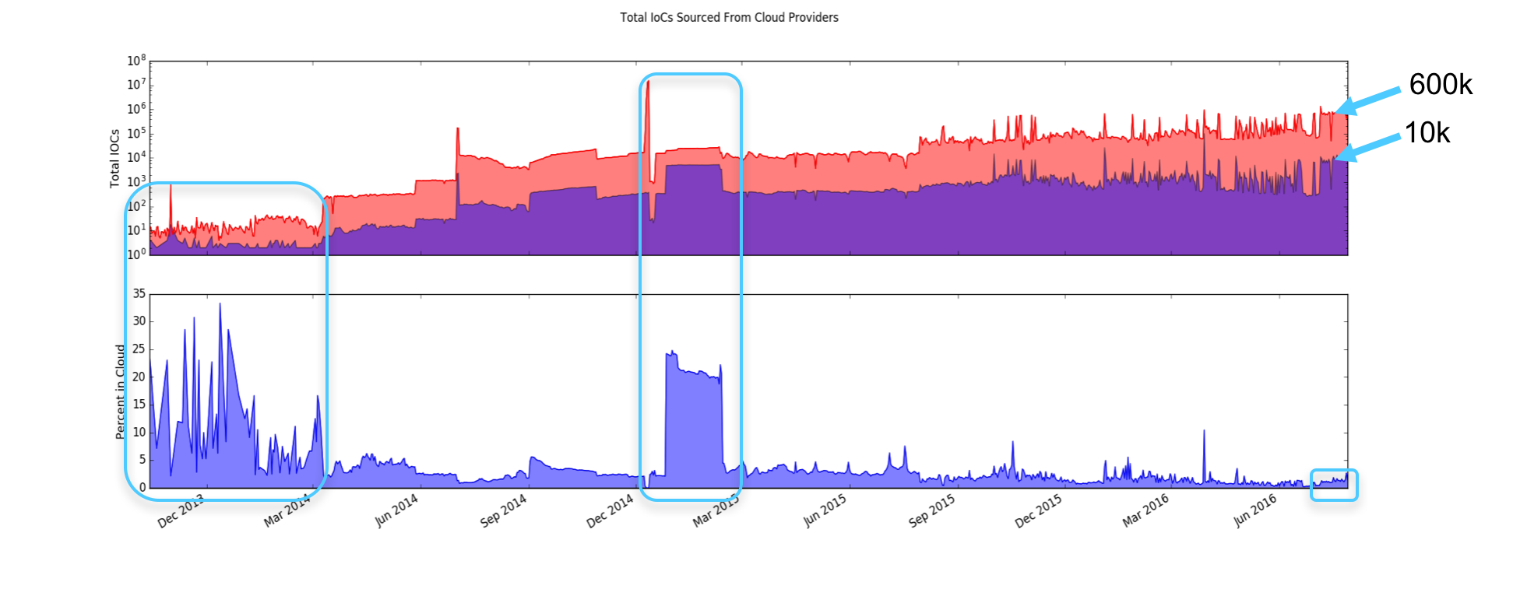
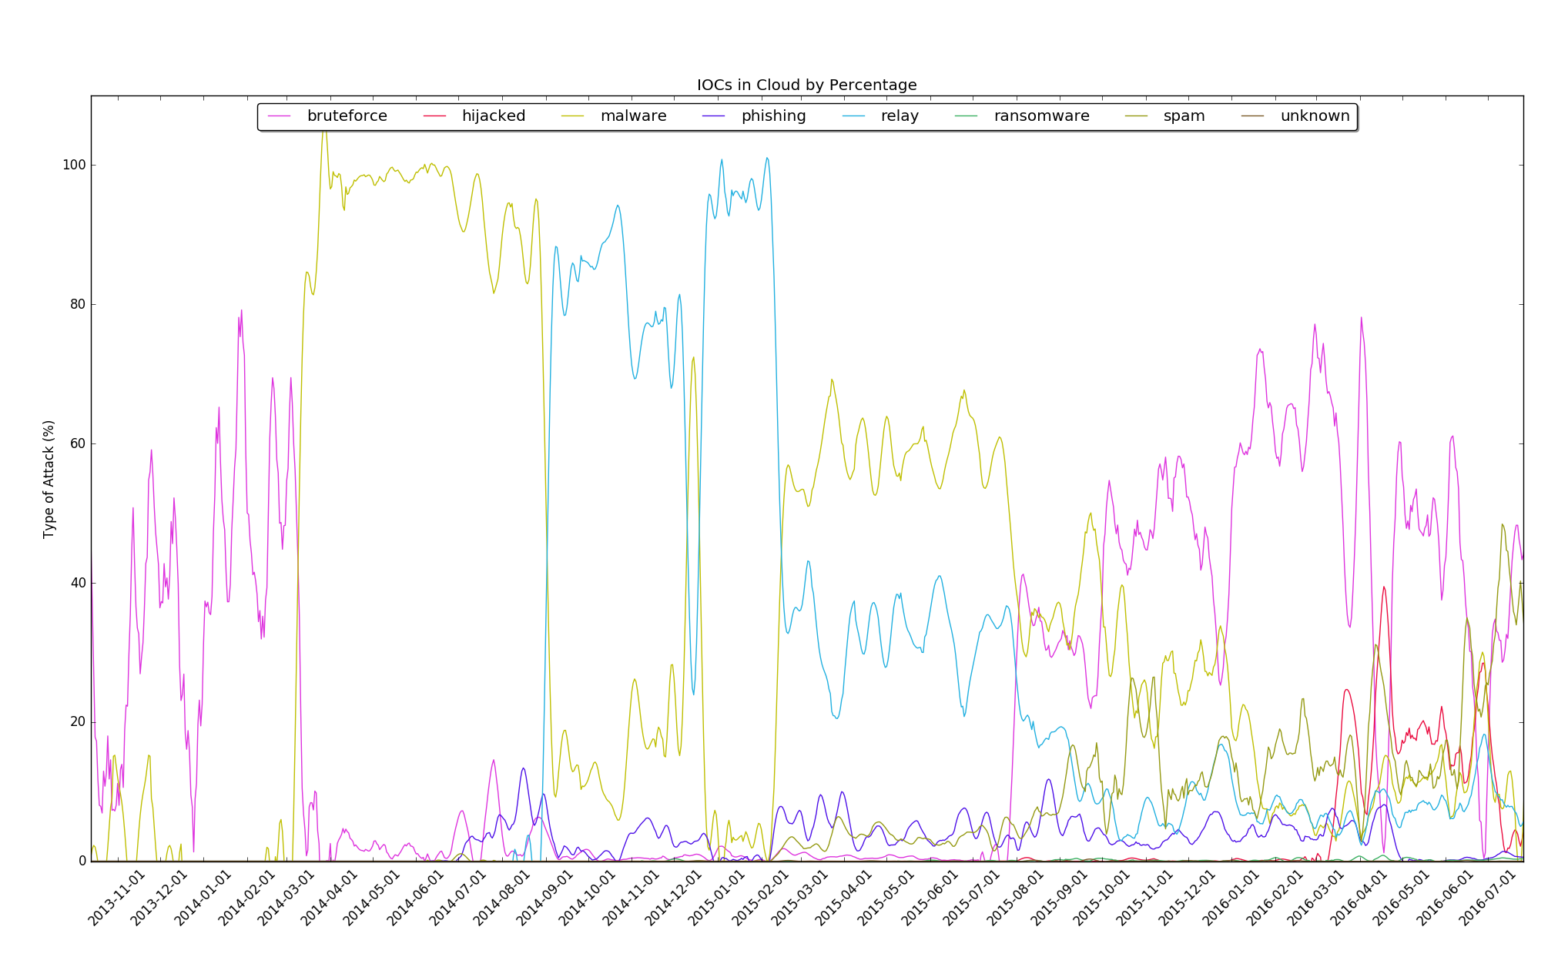
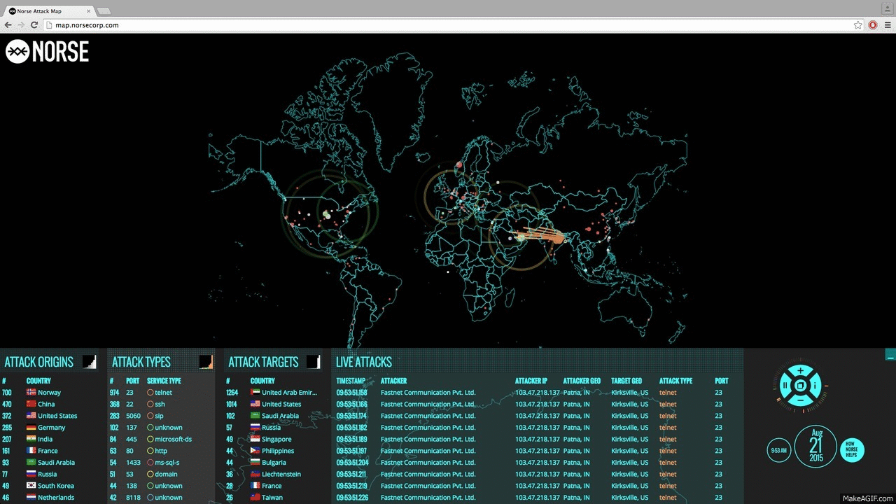
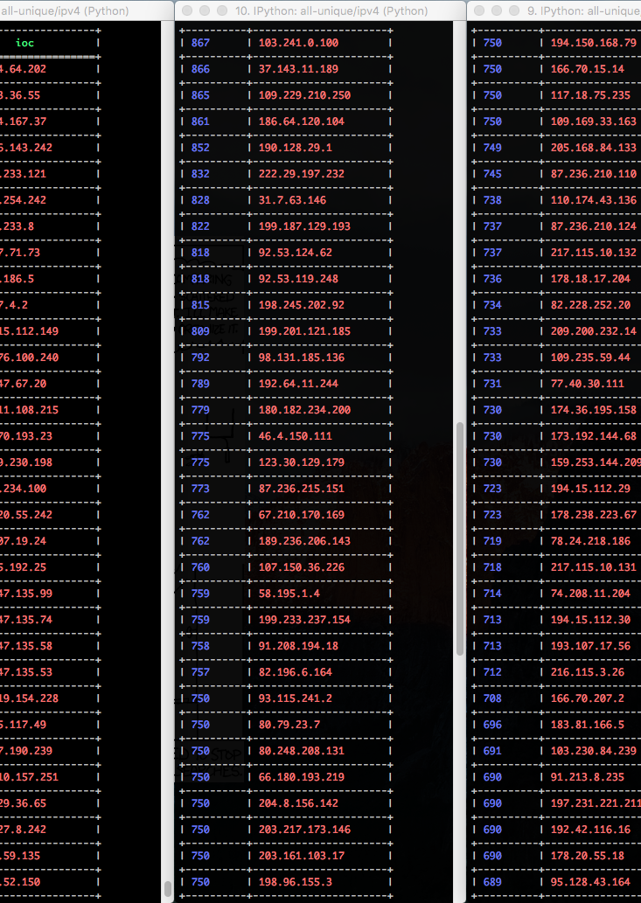
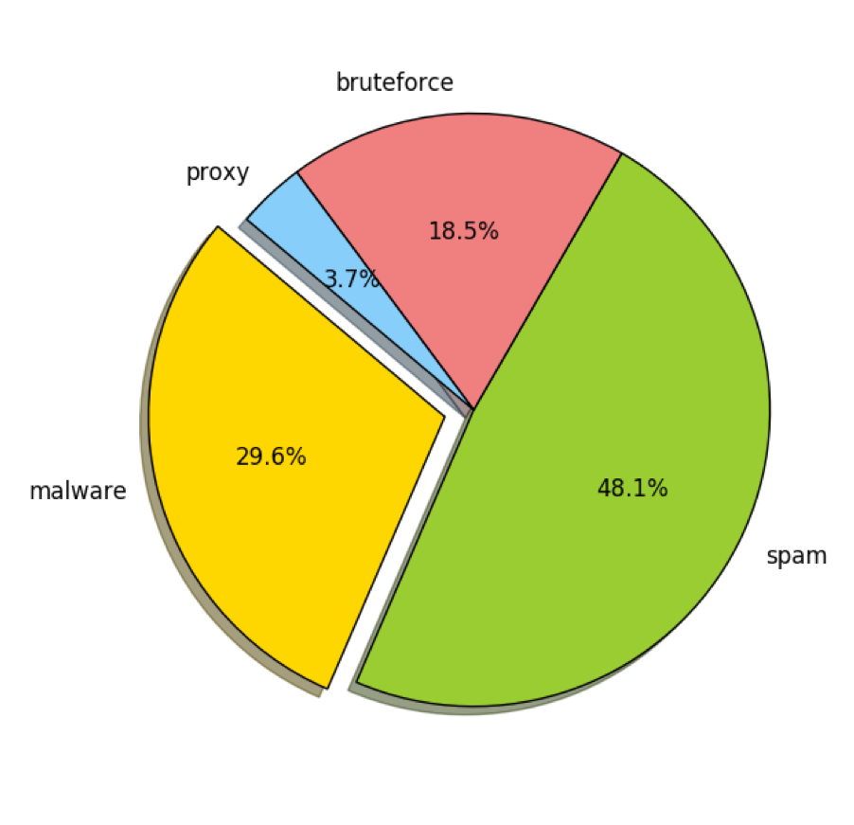
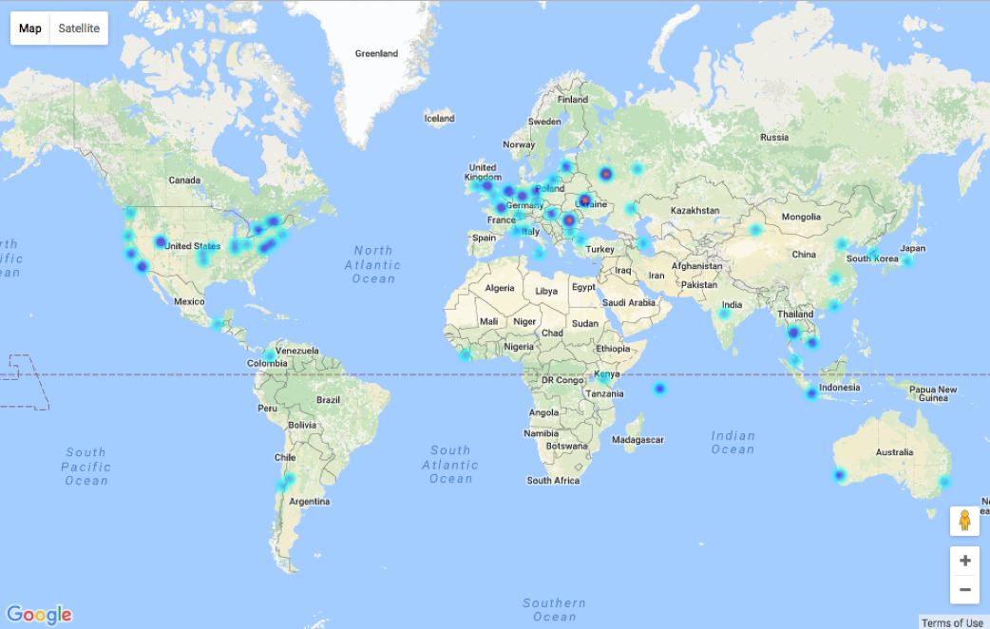
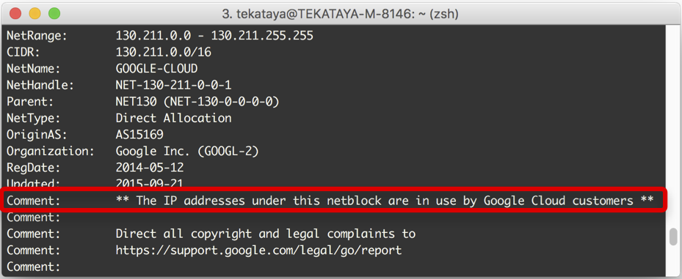

Slide 9
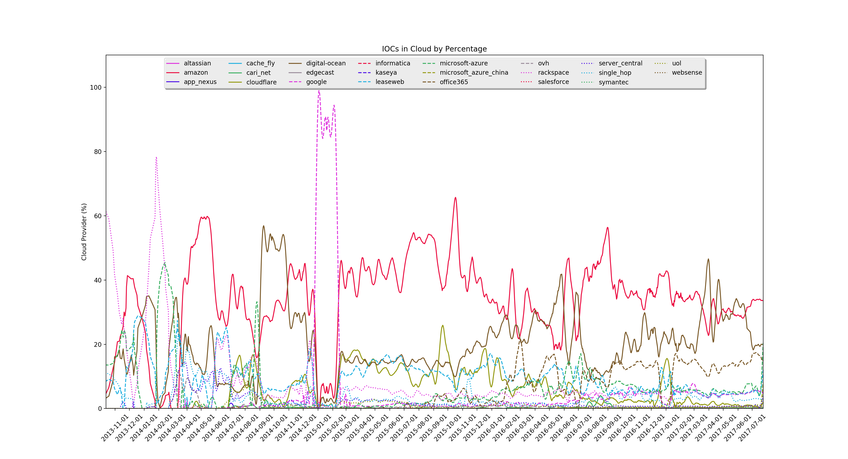

Slide 10
Statistics
July 23, 2016 IoCs Seen in Cisco DMZ Flows
Bad IP Addresses
From the Cloud
209.126.103.42 295,276
93.174.93.94 170,423
177.82.185.149 119,744
209.126.120.54 60,358
61.240.144.66 50,441
209.126.127.156 45,618
61.240.144.65 37,273
185.94.111.1 30,439
45.58.113.205 30,373
69.172.216.55 30,317
amazon 77,065
ovh 49,639
leaseweb 12,914
office365 5,293
cloudflare 3,037
rackspace 2,475
microsoft-azure 1,029
digital-ocean 48
google 43
microsoft-china 3
Total Flows: 9,400,302
Total Bad To-Cloud: 9,342
Total Blacklisted: 378,038
Unique Blacklisted: 8,996

Slide 11
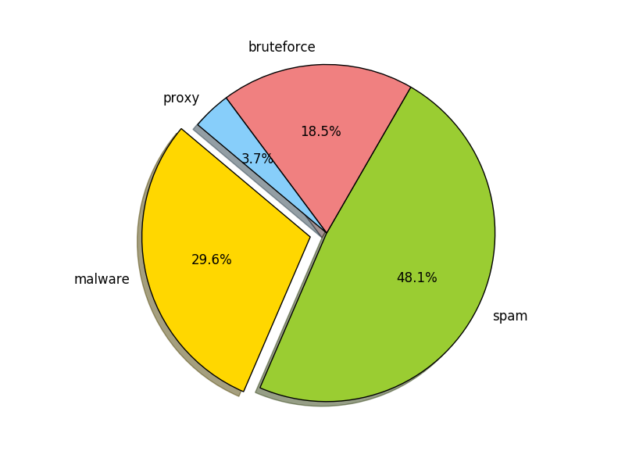
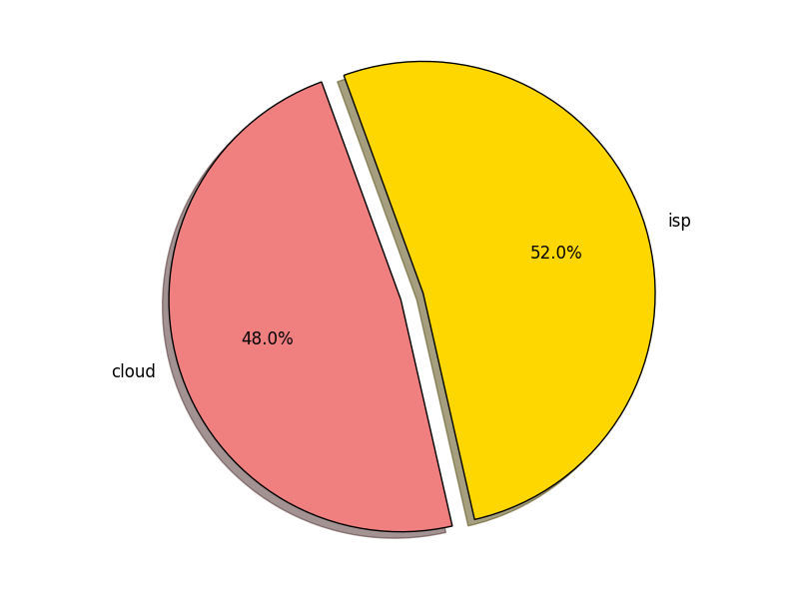
Filtered Positive Results
Amazon EC2
ServerCentral
Microsoft Azure
CariNet
AppNexus
EdgeCast
SingleHop
CacheFly

Slide 12
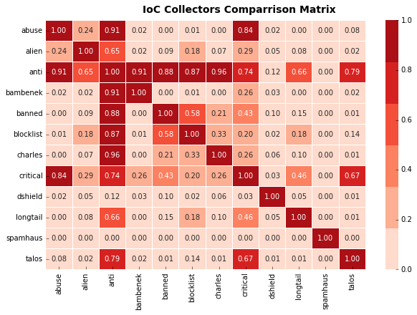

Slide 13
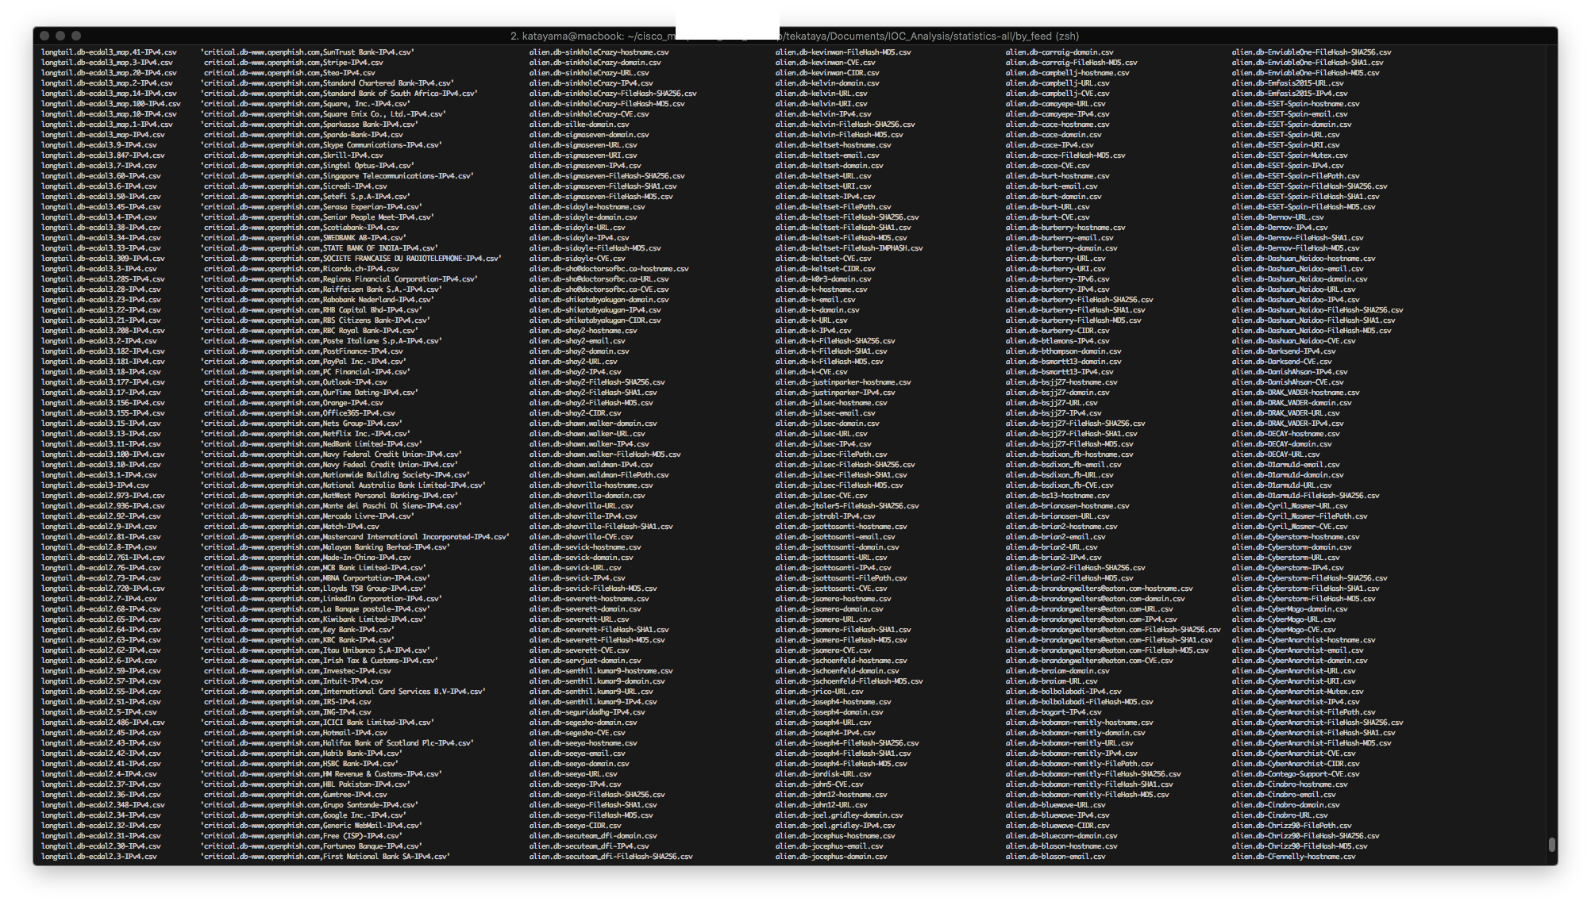
3913 IoC
Source Feeds

Slide 14
IoC Feed – Deep Study

Slide 15
IoC Feed Selection
Select feeds with high frequency of updates (at least every 15 minutes) abuse.ch (feodo, zeus, ransomware, bad_urls, bad_ips)
For feeds providing a list of IP addresses
Query Passive DNS for recent domains and URLs associated with IP
For feeds providing a list of URL addresses
Query reverse lookup for IP associated with domain
For each artifact, download payload and extract signature details
Store binary for first-seen payloads

Slide 16
IoC Payload & Signature Details
IoC Property | IoC Data Properties
ioc.status | “added”, “retained”, “removed”
ioc.datetime | Datetime when IoC artifact observed
ioc.dateadded | Datetime whe IoC reported in IoC Feed Source
ioc.ip | ipv4 address
ioc.domain | domain name
ioc,url | url address
ioc.payload_type | “exe”, “doc”, “rtf”, “jar”, “zip”
ioc,payload_hash | Sha256 hash signature provided from IoC feed source
ioc.payload_signature | Malware family provided from IoC feed source
ioc.hash | Sha256 hash computed at time of payload download

Slide 17
IoC Payoad & Signature Sample

Slide 18
IoC Binary Details
IoC Property | IoC Data Properties
ioc.status | “added”, “retained”, “removed”
ioc.datetime | Datetime when IoC artifact observed
ioc.ip | ipv4 address
ioc,url | url address
ioc.file_type | “PE32 executable (GUI) Intel 80386”, “exported SGML document”, etc…
ioc,mime_type | “application/msword”, “application/vnd.ms-excel”, “application/x-msi”, etc…
ioc.encoding | “iso-8859-1”, “utf-8”, “us-ascii”, “application/x-msibinary”, etc…
ioc.hash | Sha256 hash computed at time of payload binary download
ioc.binary | Raw Binary Data

Slide 19
IoC Binary Details Sample

Slide 20
IoC URL Observation
IoC URLs containing valid malicious payloads contain text that differs from safe URLs
Can we apply Information Retrieval techniques to classify unseen malicious URLs?
Safe URLs
udel.edu/PT/faculty/reisman_CV.html
dir.yahoo.com/Government/Military/Aviation/
en.wikipedia.org/wiki/Yorkshire_Electricity
supportforums.cisco.com/docs/DOC-13429
Malicious URLs
www.mva.by/tags/swift%20details.exe
jarmilakavanova.cz/wp-content/themes/whatsappaudio2354875235.zip
www.kudteplo.ru/r1/xls/2014/WARM.TOPL.Q1.2014.xls
www.hamanakoen.com/%E8%B2%A1%E5%8B%99%E8%AB%B8%E8%A1%A8%E7%AD%89%E5%85%A5%E5%8A%9B%E3%82%B7%E3%83%BC%E3%83%88.xlsm

Slide 21
Malicious URL Detection (binary classifier)

Slide 24
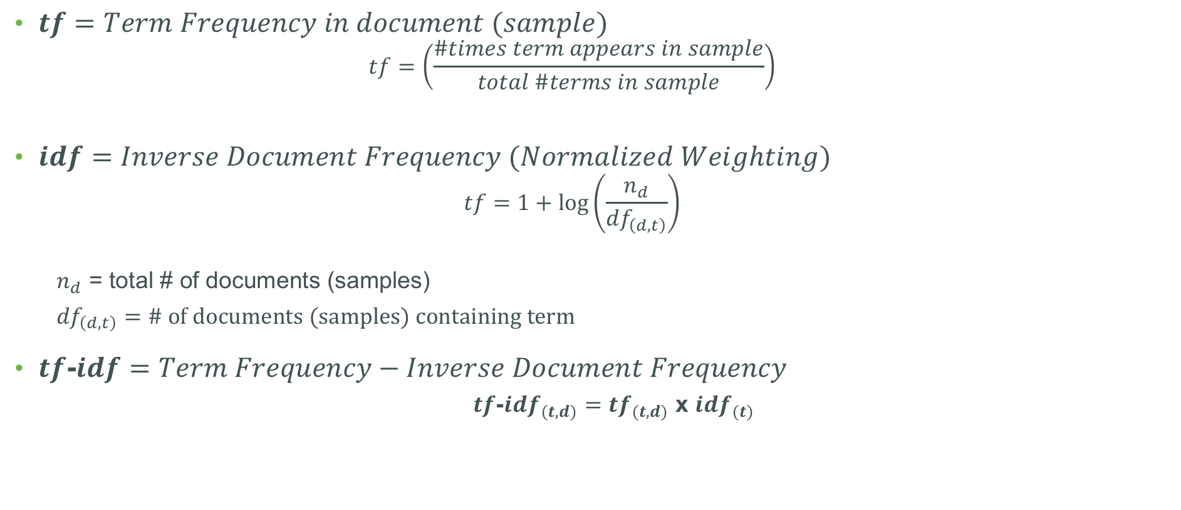
$tf=Term Frequency in document (sample)$
$$tf=\left(\frac{\#times term appears in sample}{total \#terms in sample}\right)$$
$idf=Inverse Document Frequency (Normalized Weighting)$
$$tf=1+\log\left(\frac{n_{d}}{{df}_{\left(d, t\right)}}\right)$$
$n_{d}$ = total # of documents (samples)
${df}_{\left(d, t\right)}=\# of documents (samples) containing term$
$tf$-$idf=Term Frequency−Inverse Document Frequency$
$tf$-$idf_{(t,d)}=tf_{(t,d)}$ x $idf_{(t)}$

Slide 28
Logistic Classification Report (80% | 20%)

Slide 30
URL Predictions of un-seen URLs
url | predicted | actual
4city.com.pl/Mar-20-02-20-06/Tracking-Number-6NCF66836176857985 | bad | bad
gabsten.dedicated.co.za/sites/default/files/2/commj.exe | bad | bad
expeditions.udel.edu/extreme08/microbes/viruses-help.php | good | good
ducro.nl/ups.com/WebTracking/DIZ-44503913 | bad | bad
wilmsmeier.de/Facturation-30-mai | bad | bad
sites.google.com/site/kansasriverkeeper/kcmo-sewer-project | good | good
185.144.100.123/bins/sora.arm7 | bad | bad
www.paulocamarao.com/server-log/PGDOUOUT.exe | bad | bad

Slide 31
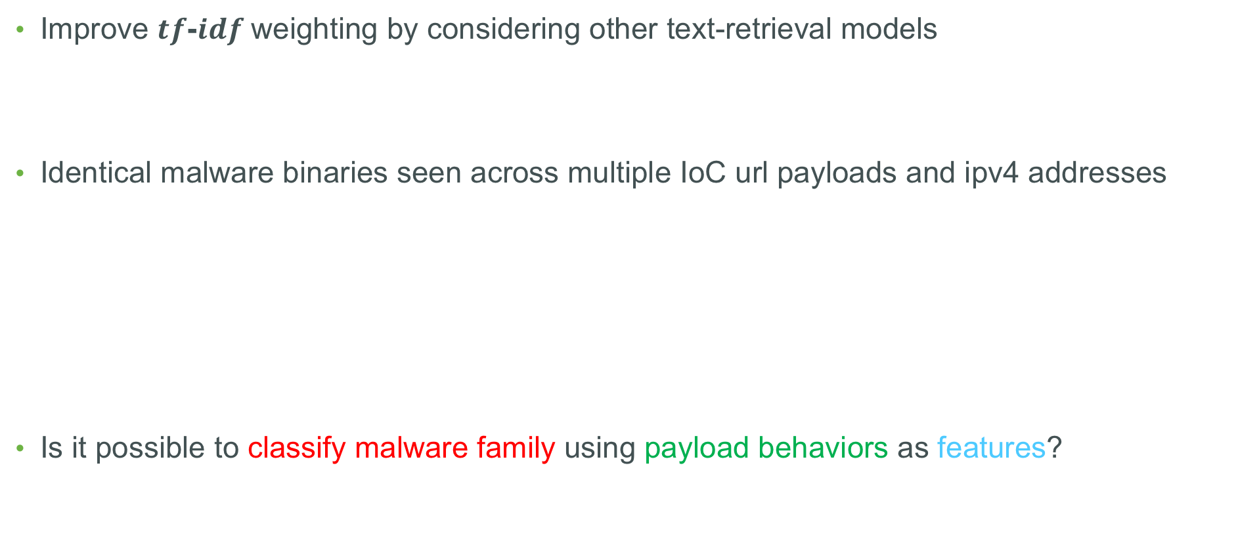
IoC URLs – Further Observations
Improve $tf$-$idf$weighting by considering other text-retrieval models
Identical malware binaries seen across multiple IoC url payloads and ipv4 addresses
Is it possible to classify malware family using payload behaviors as features?
Win32/Adware.Zdengo.CG | b2425a372548050da11bd568f8dfa736e1e952c58d0c7da86e70fcde8b4801da
2018-06-08 20:31:12 | 198.24.161.75 | http://install-apps.com/download/Setup.exe?
2018-06-08 20:34:54 | 198.24.161.75 | http://www.technologiebeloeil.com/download/Setup.exe?
2018-06-08 20:41:17 | 198.24.161.75 | http://cherriertechnology.com/download/Setup.exe?REDACTED
2018-06-08 20:49:02 | 198.24.161.75 | http://www.technologielaurendeau.com/download/Setup.exe?

Slide 32
Malware Executable Classification (binary classification)

Slide 33
Malware Payloads - Inspection
Yara – Use rules to scan binaries for known malware signatures
Yara Androguard module – used for scanning Android .apk binary
yextend – inspecting compressed files
Cuckoo Sandbox – execute binary in isolated environment and pass information to yara

Slide 34
Malware Payloads Downloaded by Type
type | count
maldoc_Tanker.yar | 44650 | MALW_Sqlite.yar | 584 | MALW_PE_sections.yar | 109 | Maldoc_CVE_2017_8759.yar | 17
packer_compiler_signatures.yar | 40980 | MALW_Retefe.yar | 562 | RAT_CyberGate.yar | 88 | APT_Irontiger.yar | 9
Maldoc_VBA_macro_code.yar | 36193 | MALW_Mailers.yar | 514 | MALW_IcedID.yar | 83 | EMAIL_Cryptowall.yar | 4
peid.yar | 28607 | CVE-2017-11882.yar | 508 | MALW_CAP_HookExKeylogger.yar | 77 | ns_malware | 1
antidebug_antivm.yar | 27852 | Maldoc_CVE_2017_11882.yar | 508 | MALW_Rooter.yar | 45
Javascript_exploit_and_obfuscation.yar | 18592 | MALW_XMRIG_Miner.yar | 240 | APT_Derusbi.yar | 42
packer.yar | 11052 | RAT_Njrat.yar | 191 | Maldoc_DDE.yar | 38
Android_Metasploit.yar | 7042 | MALW_Emotet.yar | 176 | MALW_AgentTesla.yar | 31
MALW_Miscelanea.yar | 6716 | TOOLKIT_Chinese_Hacktools.yar | 160 | EK_Blackhole.yar | 24
RAT_Ratdecoders.yar | 1468 | MALW_Pony.yar | 153 | Maldoc_PDF.yar | 21
Maldoc_PowerPointMouse.yar | 818 | RAT_Nanocore.yar | 117 | MALW_Mirai.yar | 20

Slide 35
Malware Payloads – Observation
25755 unique payloads identified as malware
Windows binaries, Android binaries, web-based injection, infected documents, etc…
6744 identified as malicious windows PE executable binaries
Can PE file meta-data be used as features for a malware binary classifier?
With 645 of HEADERS, which should be used as features?
Using 10,244 PE binaries collected from a fresh Windows 7 install as clean binaries.

Slide 36
Malware Classification Previous Research
Karthik Raman - Product Security Incident Response Team (PSIRT), Adobe Systems, Inc
Selected the following features with reported high accuracy:
Will these features hold with recent malware binaries seen in the wild?
DebugRVA | ExportRVA | ImageVersion | OSVersion
DebugSize | ExportSize | LinkerVersion | ResSize
Dll | IATRVA | NumberOfSections | StackReserveSize

Slide 37
Clean Binary Statistics

Slide 38
Malware Binary Statistics

Slide 39
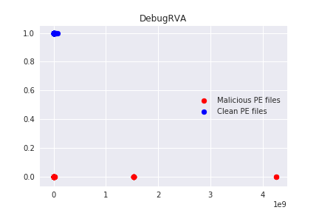
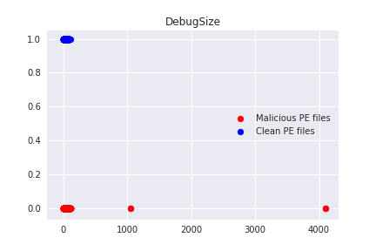
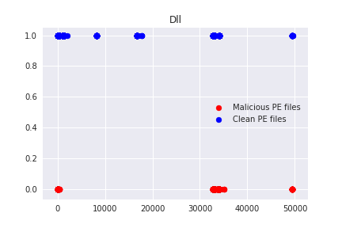
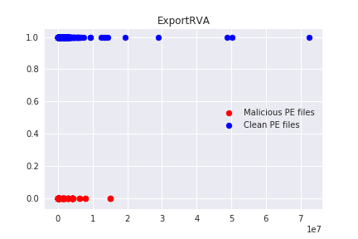

Slide 40
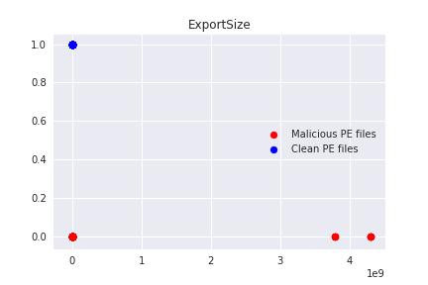
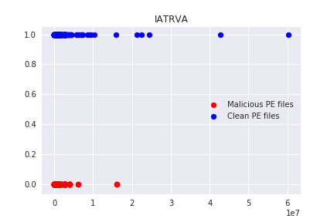
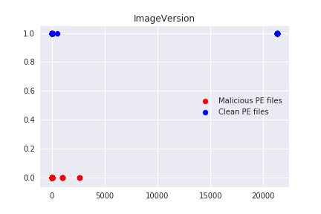
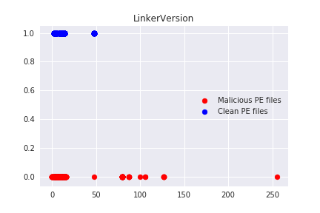

Slide 41
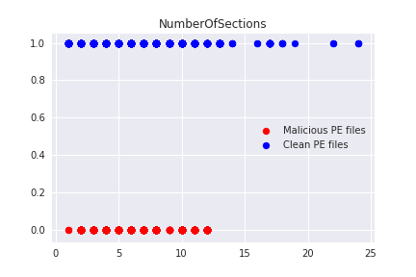
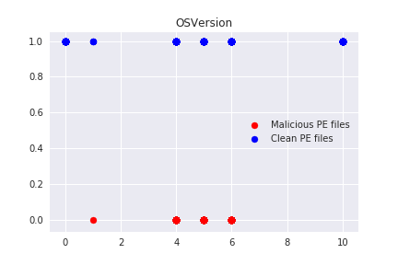
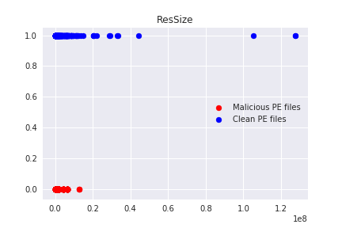
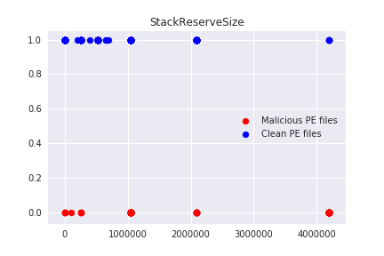

Slide 45
Features Reduction
Optimal Features
DebugRVA
DebugSize
Dll
ExportRVA
LinkerVersion
NumberOfSections
OSVersion
ResSize
Non-Optimal Features
Export Size
IATRVA
ImageVersion
StackReserveSize

Slide 46
8 Features Selected
Test 3398 samples
DebugRVA
DebugSize
Dll
ExportRVA
LinkerVersion
NumberOfSections
OSVersion
ResSize
Accuracy: 99.85 %
TN = 1352
TP = 2041
FP = 2
FN = 3

Slide 47
IoC Malware – Further Observations
Using URL statistics, can we classify malicious binary to malware family?
Can time reported (added to feed), time retained and time removed be used as features?

Slide 48
IoC Active Threat Predictor (binary classification)

Slide 49
IoC Observations
IoCs recently added to a feed are typically active (True Positive)
Contains malicious payload/binary
Over time, the IoC becomes inactive but remains in the feed (False Positive)
No longer contains malicious payload/binary
Ipv4 address recycled, domain shutdown, server patched and/or taken off-line, etc…
Eventually, the benign IoC is removed from the feed
Given a particular feed statistics and observed IoC behavior is it possible to predict where and IoC is currently an active threat?

Slide 50
Features
<t1 – avg time to remove IP address from threat feed>
<t2 – elapsed time IP address has been on feed>
<geo – IoC seen in recent top 100 bad geographic location> [0,1]
<asn – IoC seen in recent top 100 bad ASN> [0,1]
<cloud – IoC seen in cloud provider known to host malware> [0,1]
(time IoC address became benign)
Prediction

Slide 51
IoC Feed Statistics – Observation
2017-07-03 02:49:05 | c46e32828b317bb773c31ebefd96dc1fc5228430b138ea6247db…
2017-07-03 14:29:44 | 2deeb3f922fe16fca821af9f095a13b306e61c2974878cccaae10…
2017-07-09 04:02:03 | 2deeb3f922fe16fca821af9f095a13b306e61c2974878cccaae10…
1) javascript http-redirect attack
2) HTML tag / script injection attacks
3) Malware Binaries 4) cgi-bin config file
Top 10 Ports

Slide 52
IoC Active Threat Predictor
Study is on-going
Results will be presented at next Review

